Slide 1
Project
LAUNCH
Ensuring the Future of the Passamaquoddy Tribe by Preserving Heritage, Embracing Resiliency and Enhancing Strengths

Slide 2
Learning Objectives
Describe Promising and evidence based practices that are culturally appropriate and/or adaptable for tribal families and communities.
Summarize strategies that support community resiliency
Identify strategies that support resiliency by reviewing evaluation data collected by Passamaquoddy LAUNCH

Slide 3
Overview of the Passamaquoddy Tribe
Known as the People of the Dawn and the People of Spear Pollack
Tribal Enrollment Approximately 3600 people
  60% of the population is under the age of 35
  12% of the population is over the age of 60
2 Reservations located in Rural Washington County, Maine
  Indian Township
  Pleasant Point

Slide 4
On Reservation Demographics
65% not-employed rate (less during summer months)
High levels of poverty
  63% of Passamaquoddy make less than $25,000/year
  24% of Passamaquoddy households make less than $10,000/year
High Rate Substance Abuse in both communities
  100% CPS cases are due to substance abuse within families

Slide 5


TRIBAL RESPONSE: APPLY FOR SAMHSA GRANT
Linking
Action to
Unmet
Needs in
Children’s
Health

Slide 6
Project LAUNCH and the Passamaquoddy Tribe
5 year grant award (10.01.14 – 09.30.19): LAUNCH Cohort 6
Shared initiative between Indian Township and Pleasant Point
  Passamaquoddy Health Center
  Pleasant Point Social Services
Passamaquoddy LAUNCH has 2 primary areas of focus:
  Infrastructure development
  Service Delivery

Slide 7
National Project LAUNCH
Prevention and Promotion Strategies
Screening and assessment in a range of child-serving settings
Integration of behavioral health into primary care
Mental health consultation in early care and education
Enhanced home visiting with a focus on social and emotional well-being
Family strengthening and parent skills training

Slide 8
LAUNCH Staffing
Indian Township
Pleasant Point
Project Director/Young Child Wellness Expert
Maternal Child Health Coordinator (shared)
Family Advocate
Family Support Specialist
Local Child Wellness Coordinator
Family Advocate
Family Support Specialist
* Senior Program Consultant and Evaluator are contracted for both sites

Slide 9
Initial Grant Requirements
Prior to implementing any LAUNCH Services, there were several requirements to complete:
  Develop a Disparity Impact Statement to identify a specific focus
    School readiness
  Establish a Local Child Wellness Council and Joint Child Wellness Council
  Complete a comprehensive Environmental Scan
    Existing resources that support children and families
    Identify gaps in services for children and families
  Develop a 5-year strategic plan
    Prioritize Areas of Focus
  Develop an Evaluation Plan

Slide 10

Local Child Wellness Councils

Slide 11

Local Child Wellness Council
Representative of Key Stakeholders
Parents & Caregivers
Child Serving Agencies
Intended to Advise and Guide the work
Local Child Wellness Councils will meet monthly.
Combined IT and PP Child Wellness Council will meet every third month.
Three Councils
Indian Township
Pleasant Point
Combined IT and PP
Notes:
The goal is to receive input from the council members on the strategies LAUNCH covers as well as how these strategies will be implemented in the community.
This is also a time for networking and sharing of information, creating partnerships.
Community members and family members are also invited to voice their concerns, thoughts and ideas.

Slide 12
LCWC Composition: Tribal Reps
Tribal Leaders
Tribal Elders
Family Members
Health Department
  Directors
  BH Staff
  Nutrition/WIC
  Dental
Social Services /CPS
Law Enforcement,
Domestic Violence program,
Public Safety (EMS)
Head Start
Tribal Immersion Program
Tribal School Staff:
  Principal
  Superintendent
  School Board
  School Counselor Health & Wellness Coordinator

Slide 13
LCWC Composition: State/County Wide Reps
Community Caring Collaborative – Former LAUNCH grantee (cohort 1)
Child Care Providers
Family Futures Downeast
St. Croix Community Connections
Coastal Enterprises, Inc.
Next Step Domestic Violence Program
FedCap
National Alliance for Mental Illness
Passages
Wabanaki Public Health District
Wabanaki Vocational and Rehabilitation Program
Gadakina
Four Directions

Slide 14
LCWC Prioritizing Services and Activities
Indian Township Child Wellness Council :
  Support existing services
    Increase use of existing resources
  Expand community strengthening activities
Pleasant Point Child Wellness Council:
  Community Strengthening
  Family Strengthening

Slide 15
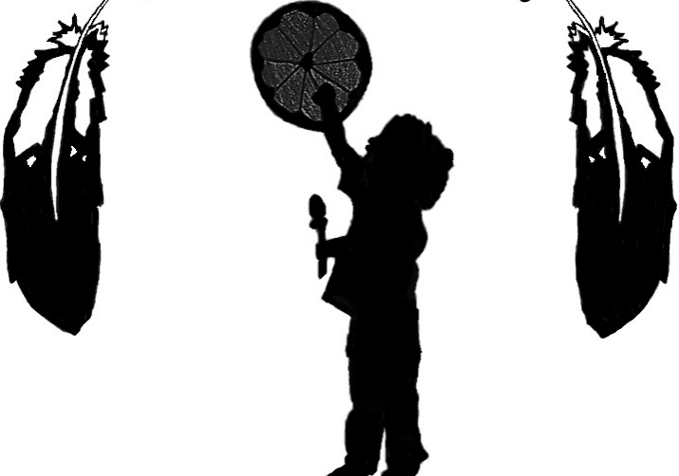
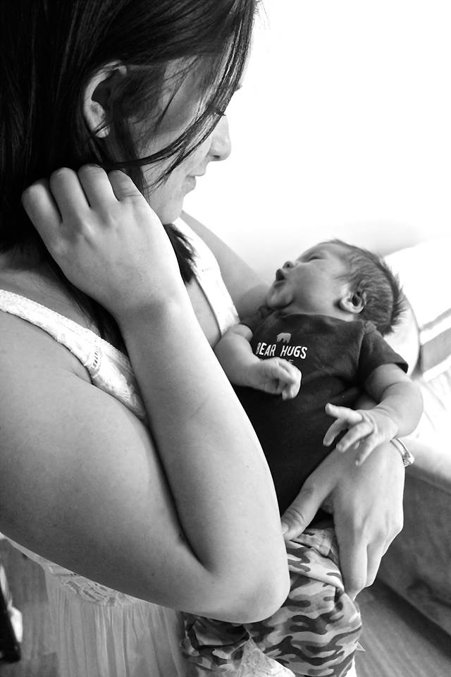

Passamaquoddy Project LAUNCH Services

Slide 16
Note:
LAUNCH is designed for children and families 0-8. In the Passamaquoddy LAUNCH design, the Tribe determined that although children 0-8 would be our target, we would not turn families away.

Slide 17
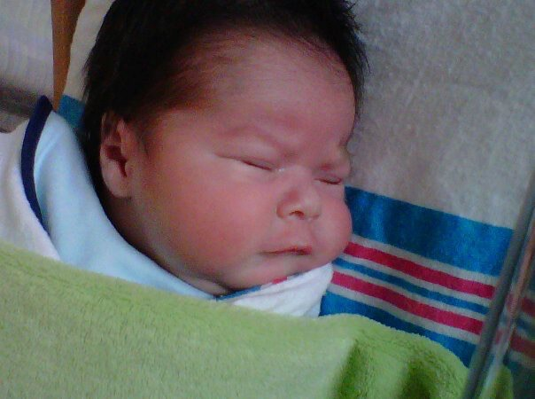
Screening and Assessment
Screening provided at multiple sites for children ages 0-5 using the ASQ Developmental Screening tool:
  In home
  School
  Daycare
  WIC (in process)
Maternal depression screening provided using the Edinburg Depression Scale
  In home
  WIC (in Process)

Slide 18
Mental Health Consultation: Early Childhood Consultation and Outreach (ECCO)
Infant and early childhood mental health consultation (IECMHC) is a multilevel approach to promotion and prevention that teams mental health professionals with people who work with young children and their families to improve their social, emotional, and behavioral health and development.
Use of a mental health clinician to build the capacity of families, providers, programs, and systems to foster children’s social, emotional, and behavioral health and development
Observation of children, child care settings, and classrooms, classroom management support, and modeling and coaching
Screening and assessment to support the early identification of children with or at risk for mental health challenges
Referrals and follow-up for children and families to community-based services
Training and staff development activities to build providers’ knowledge of mental health issues in infancy and early childhood

Slide 19
Bridging: Enhanced Home Visiting
Family Advocates and Family Support provide home visiting services for Passamaquoddy families
HV services provided at varying levels depending on the need of the family
Staff are trained using a specific curriculum to provide Bridging Services
  Infant and Family Support Services (IFSS)
IFFS 5 day training that create common framework that includes:
  Core values
  Shared knowledge base
  Skills
  Wraparound approach to service delivery
      Strength based
      Individualized services

Slide 20
Bridging as an Enhanced HV approach
  Intensive level of supportive services for an infant/child and their family
  Built on a responsive strength based relationship between the family and the IFSS
  Intent is to improve outcomes for infants/children with serious risk factors such as Neonatal Abstinence Syndrome
  Guarantee that needed services and supports are in place at the intensity level required by a family

Slide 21
Family Strengthening, Parent Skills Training and Workforce Development
Family Support/Strengthening
Workforce Development
  Brazelton Touchpoints Training
  Domestic Violence Awareness
  Youth Mental Health First Aid
  Fatherhood is Sacred and Motherhood is Sacred
  Partners for a Healthy Baby
  Financial Wellness
  Restorative Justice
  Transportation Safety
  Family Connections
  Historical Trauma
  Mandated Reporting
  Confidentiality
  Self-Care
  Expert Witness Training

Slide 22
Supporting Resiliency and Community Strengthening
  New Year Celebration
    Promoting forgiveness and starting fresh
  Health Fair
  Baby Bundles ( in development)
    1st welcome bundle
      Moccasins, blankets and tribal medicine
      Books – What to Expect the 1st Year, Baby books
    Additional bundles will include
      Sign Language cards written in Passamaquoddy
      Suggestions for developmentally appropriate activities
      Small Regalia additions
  Women’s Circle
    Sweet grass picking
    Making regalia
    Shawls
    Moccasins
    Drum Making
    Basket Making
  Lunch & Learn
    Financial Wellness, Budgeting, financial crisis
    Domestic violence awareness
    Health and Wellness
  Family Fun Days
    Kick Off Event for Tribal Ceremonial Days

Slide 23
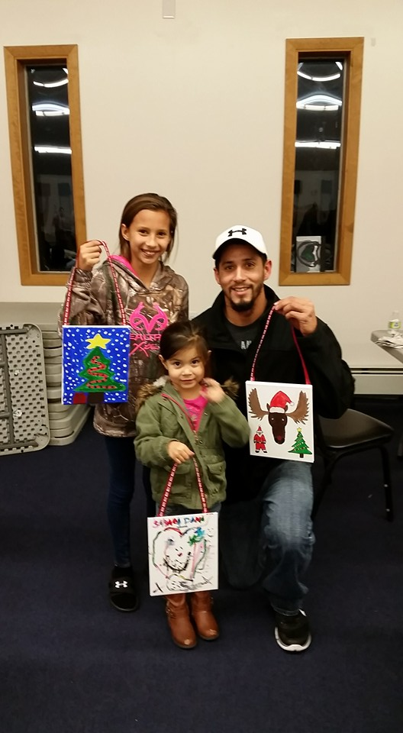
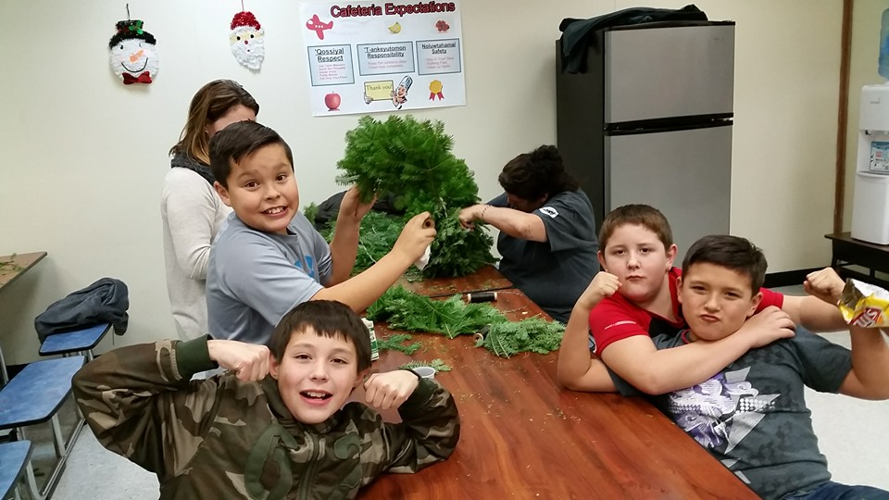
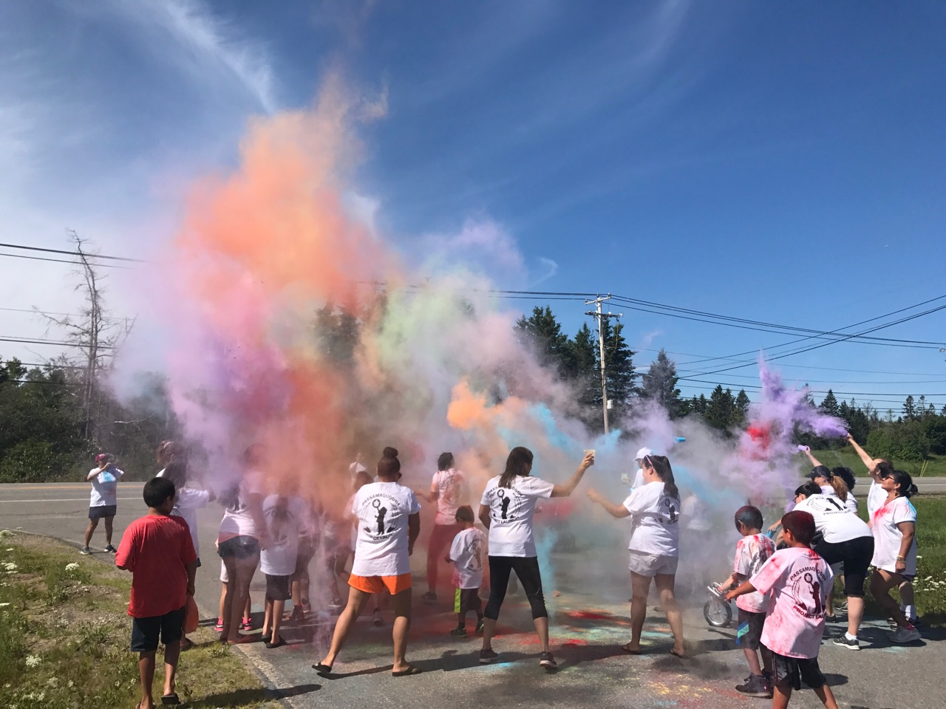
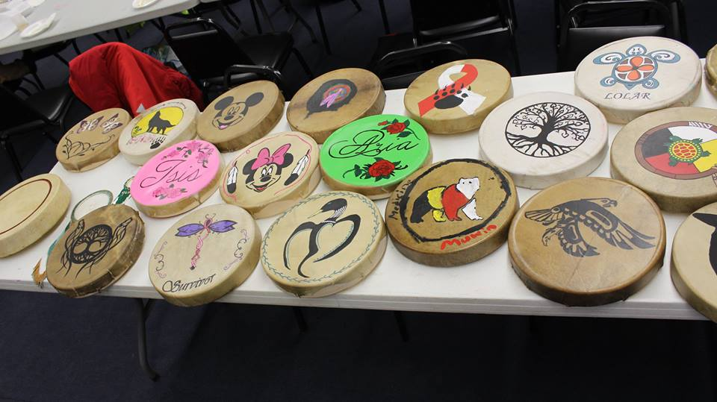
Family Focused Activities

Slide 24
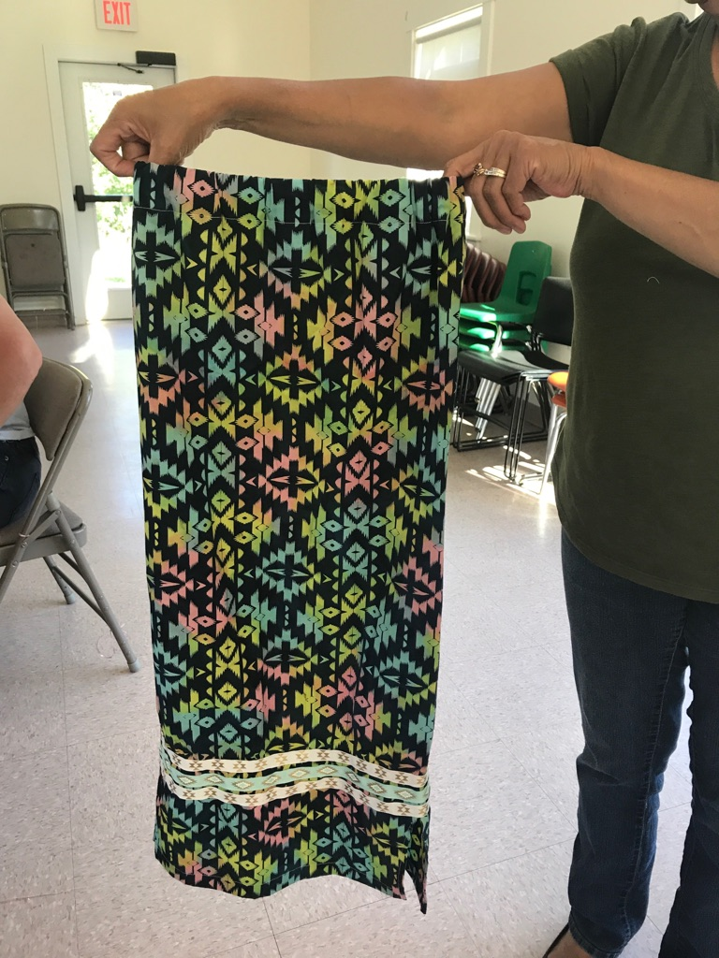
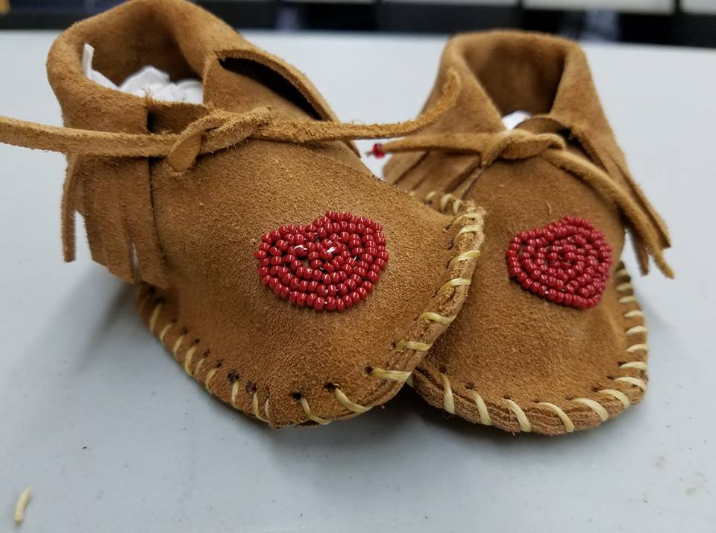
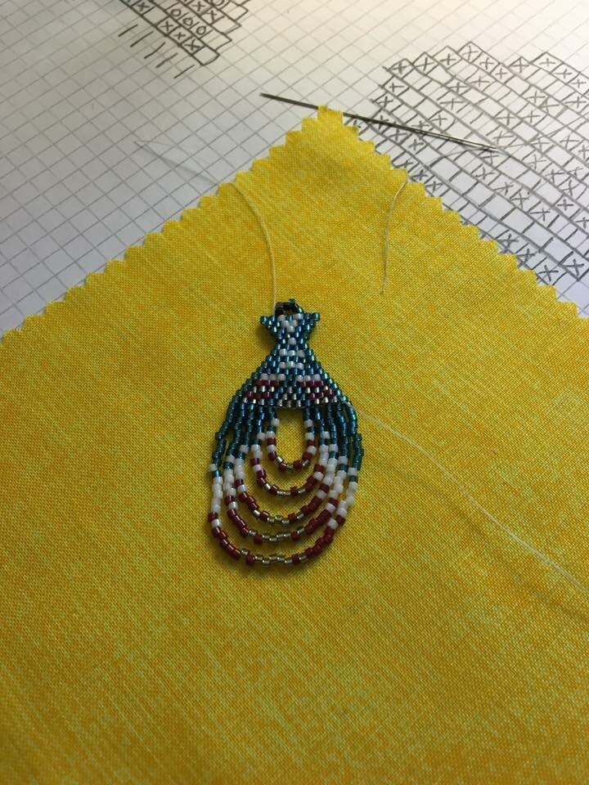
Women’s Circle

Slide 25
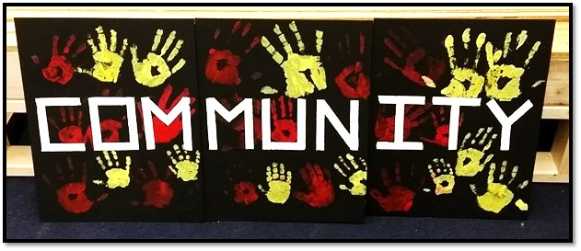
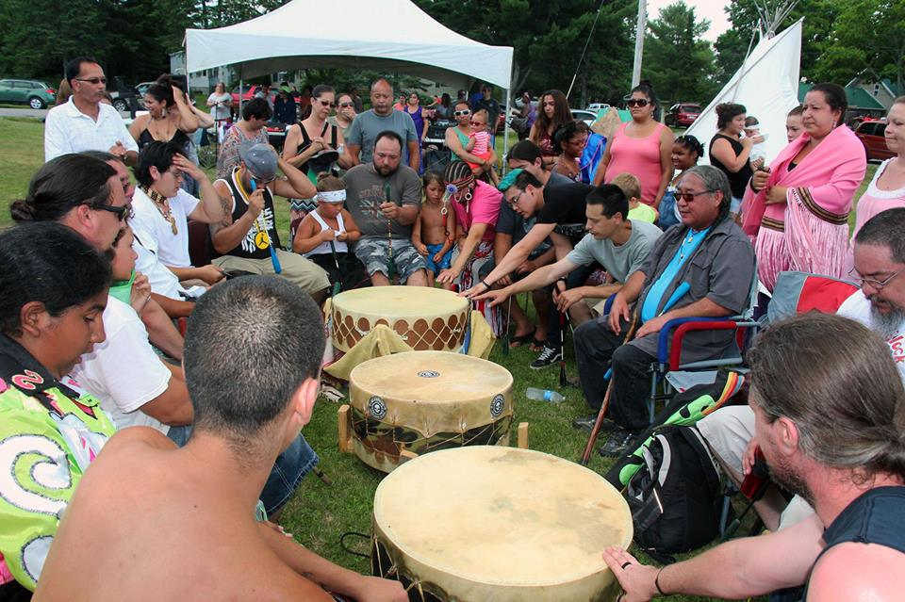
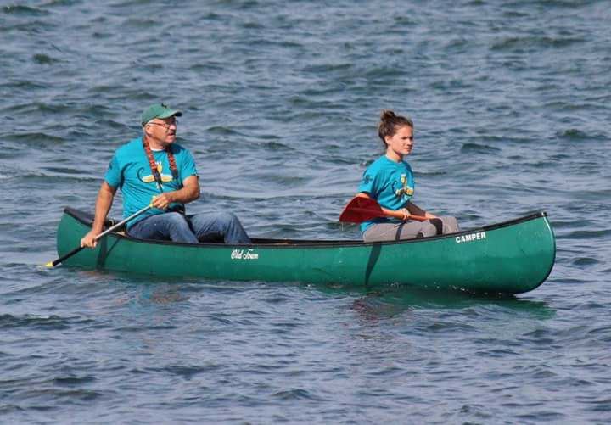
Community Events

Slide 26
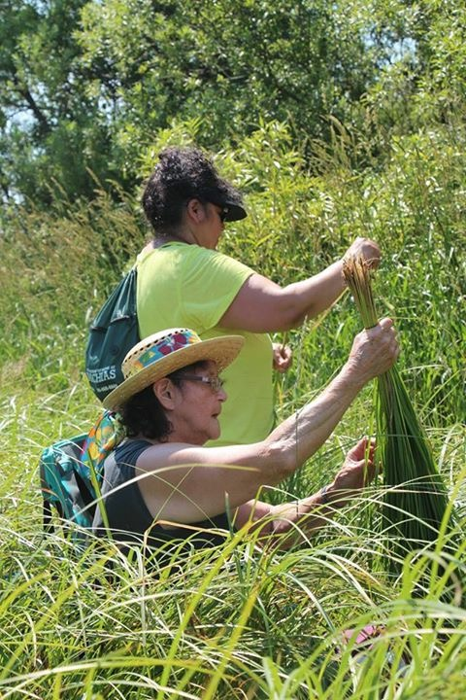
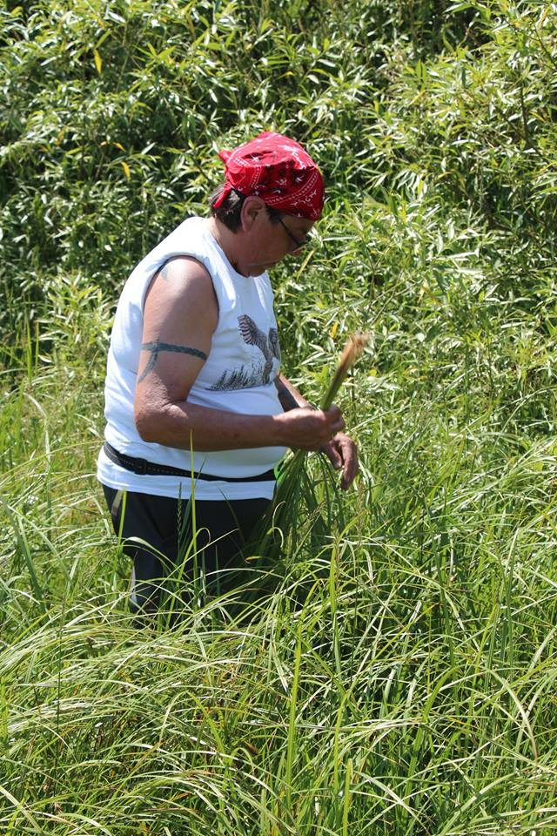
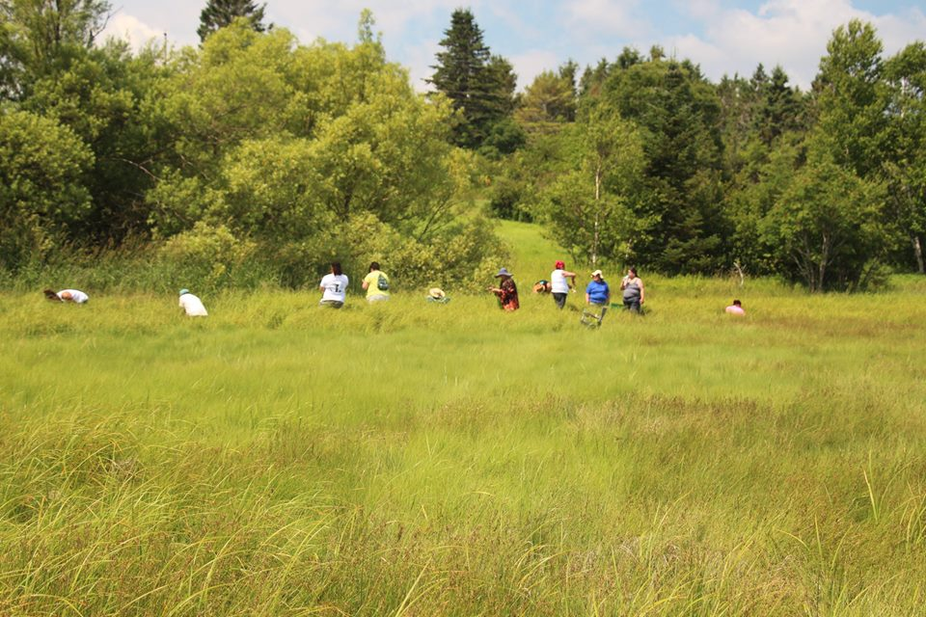
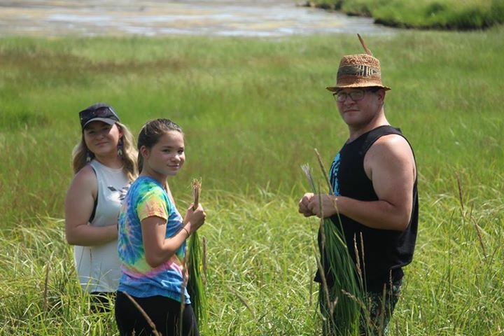
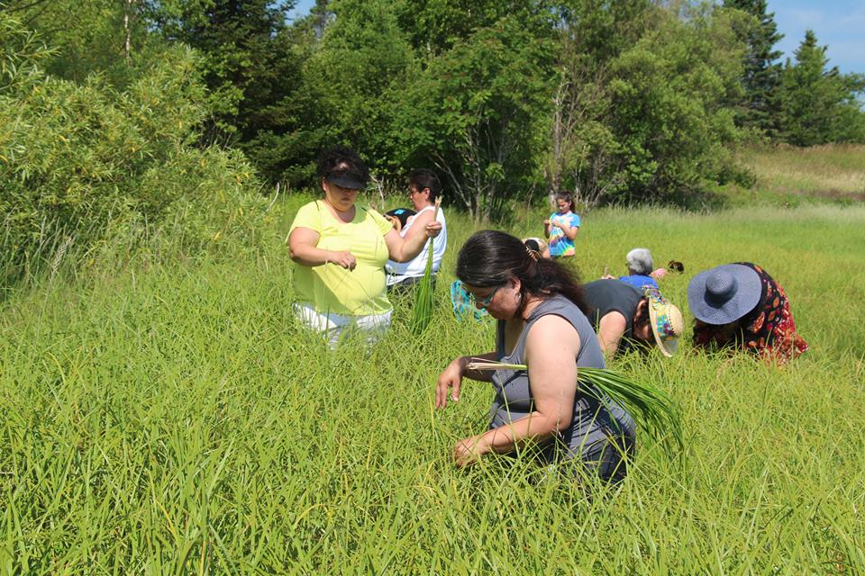
Community Events Continued

Slide 27
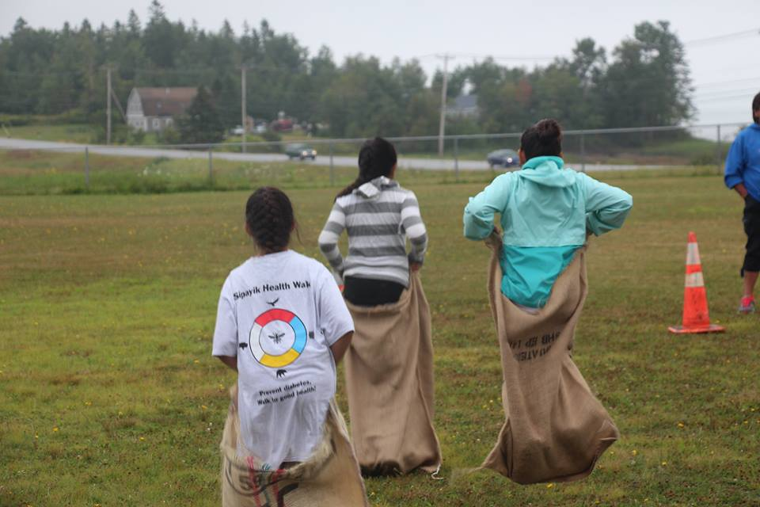
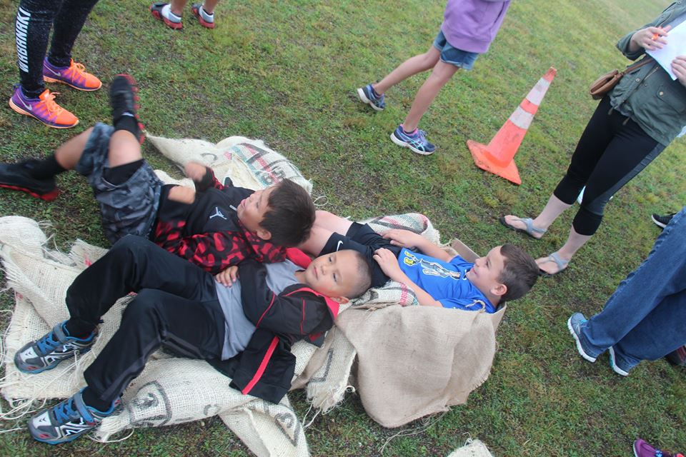
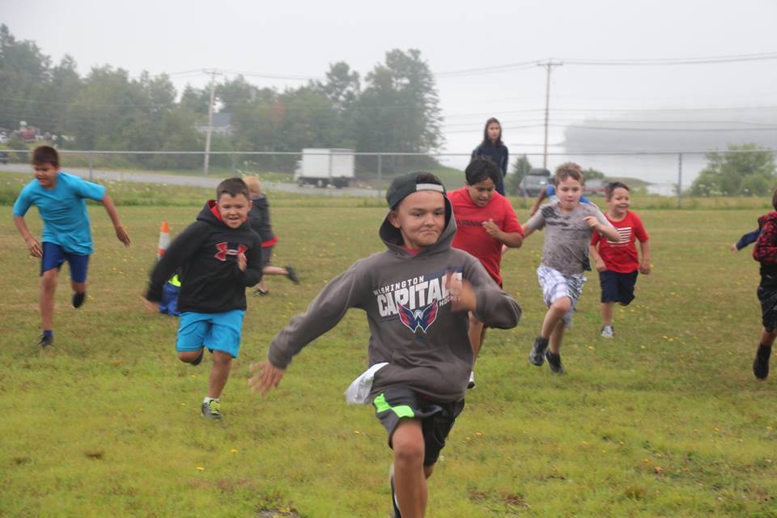
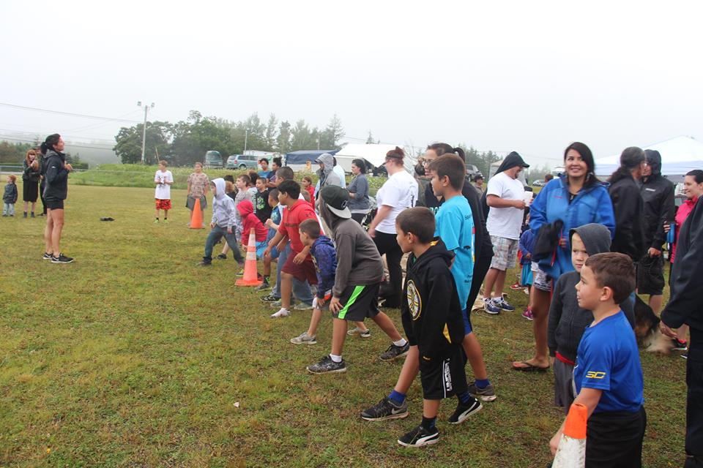
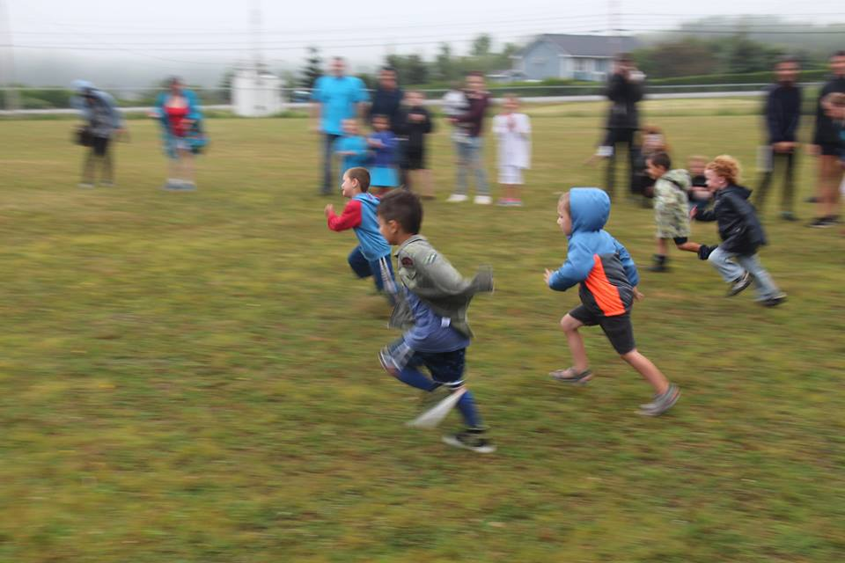
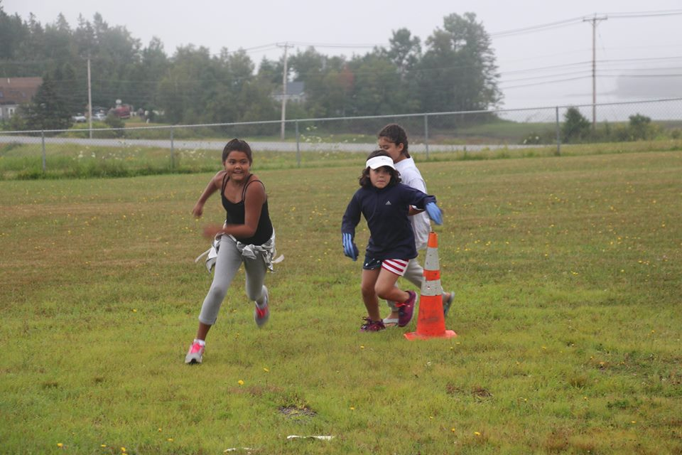
Family Fun Days

Slide 28
Passamaquoddy Project LAUNCH Evaluation

Slide 29
Passamaquoddy Project LAUNCH Evaluation
Federal SAMHSA Evaluation Requirements
Local Passamaquoddy Evaluation Priorities
Every Quarter
  CDP / TRAC / SPARS
Every 6-Months
  MSE – direct services
  Mid-term report
Annually
  Annual report
    Measure changes at:
    systems level, provider, parent, and child
  MSE – Systems
Annually
Community Connectedness /
Strengthened Passamaquoddy Tribe
Healthy Passamaquoddy families
2-Generation / Multi-generation model

Slide 30
Passamaquoddy Project LAUNCH Theory of Change: 2014-2019
Workforce Development & Economic Assets
Educational Success
Health and Wellbeing
Social Capital
2 GEN MODEL
Systems
Strengthened Tribal infrastructure and increased wellness in Passamaquoddy families
Provider
Improved provider knowledge, attitudes, and practices
Parent
Increased hope for the future
Child
Improved health and mental health for infants and children
Family / Community
Healthy Passamaquoddy families with increased resiliency and self-empowerment
LAUNCHMODEL
Infrastructure
Advocacy
Services
Training & Education
Evaluation &
Assessment
Enhanced
Home
Visiting
Screening &
Assessment
Integrated Care
ECCO
Family & Parent Strengthening

Slide 31
Passamaquoddy Project LAUNCH Evaluation Priorities
Community Connectedness / Strengthened Passamaquoddy Tribe
Impact of LAUNCH Community Activities
Evaluation Tools: Community Activities Surveys, Observations and Anecdotes, Project LAUNCH Access Database.
Healthy Passamaquoddy Families
Impact of LAUNCH Direct Services:
(1) Home-visiting; (2) Integrated Care; (3) Screening and Assessments; (4) ECCO; (5) Family and Parent Strengthening
Evaluation Tools: Parent Surveys, Provider Surveys, Project LAUNCH Access Database
2-Generation / Multi-generation Approach
Impact of Passamaquoddy Project LAUNCH 2 Gen / Multi Gen Approach
(How do LAUNCH direct services, community and educational activities impact Passamaquoddy families and the community?)
Evaluation Tools: Parent Surveys, Community Activities Survey, Provider Surveys, LAUNCH Staff Surveys, Project LAUNCH Access Database,
Collaboration/Partnership Assessments, Observations, and Anecdotes

Slide 32
Project LAUNCH Community and Family Strengthening Events | Adults | Kids | Total Community Contacts
Quarter 3: 4/1/2016 - 6/30/2016
IT: Women’s Circle (April, May, June) | 146 | 6 | 152
IT: Paint with me (4/20) | 17 | 31 | 48
IT: Round Table discussion rec. center (5/11) | 20 | 0 | 20
PP: Women’s Circle (April, May, June) | 104 | 5 | 109
PP: Family Fun Day (4-18-16) | 85 | 138 | 223
PP: Paint with Me (4-20-16) | 13 | 27 | 40
PP: Youth Mental Health First Aid (5-9-16) | 10 | 1 | 11
PP: Indian Taco Game Night (5-20-16) | 50 | 49 | 99
PP: Dads group | 10 | 1 | 11
Joint: Wabanaki Spring Social | 150 (est.) | 150 (est.) | 300
Joint: Social for College Expo (5/5) | 50 | 50 | 100
Joint: Career and college expo (5/6) | 20 | 80 | 100
TOTAL COMMUNITY CONTACTS | 675 | 538 | 1213
Quarter 4: 7/1/2016 - 9/30/2016
IT: Women’s Circle (July 6,20 Aug 3,10,17,24 Sept 14,21) | 102 | 26 | 128
IT: Men’s Circle (7/18) | 3 | 0 | 3
IT: Family Fun Day (7/15) | 42 | 116 | 158
IT: Indian Days (7/16-7/17) | 250 | 125 | 375
IT: Health Fair (9/22) | 303 | 257 | 560
PP: Women’s Circle (July 12,19,20, Aug 9,10, 23, 30, Sept 9/27) | 122 |  | 122
PP: Men’s Night (8/17) | 8 |  | 8
PP: Health Fair (8/12) | 150 (est.) | 50 (est.) | 200
PP: Mommy and Me Shawl Making (8/23, 9/6, 9/19) | 55 | 37 | 92
PP: National Indian Day (9/22) | 150 (est.) | 150 (est.) | 300
PP: Hunters Dinner (9/28) | 11 | 7 | 18
PP: Indian Day Children’s Games (8/13) | 25 (est.) | 50 (est.) | 75
PP: Children's Dance (8/19) | 10 (est.) | 50 (est.) | 60
Joint: Sweet grass Picking (8/18) | 15 | 1 | 16
TOTAL COMMUNITY CONTACTS | 1246 | 869 | 2115

Slide 33
Community Connectedness (Evaluation Priority 1)
What do you like about the LAUNCH community activities?
“Activities promote positive engagements in the community, and provide opportunities to bond.”
“I love that we all get together as a community.”
“LAUNCH brings people together.”
“It brings the community together, get to do fun activities.”
“The positive vibes, smiles, great advertising, it’s what the community needs.”
“The chance to get out and make friends.”
“Love the activities and change to socialize.”
Source: Passamaquoddy Project LAUNCH Evaluation Report Year 2.
2016: 43 Community activities. Survey responses: n=35

Slide 34
Community Connectedness (Evaluation Priority 1)
How has participation in LAUNCH community activities helped your family?
“Gets me out, making things with my children.”
“LAUNCH brought family and friends together for a fun evening.”
“Inspiring to do more activities in my own community.”
“Make bonds and grow as a unit with other families.”
“Makes me want to do more activities with my family.”
Source: Passamaquoddy Project LAUNCH Evaluation Report Year 2.
Year 2: 43 Community activities. Survey responses: n=35

Slide 35
Healthy Passamaquoddy Families (Evaluation Priority 2)
In what ways have LAUNCH Services helped you and your child(ren)?
“Assistance in getting to appointments.”
“Now I know there is always someone there whenever I need someone for whatever reason - even someone to talk to.”
“ She (LAUNCH worker) provided great advice on how to deal with our children's well-being.”
“The LAUNCH worker was super helpful on helping us find a better routine that fit for us.”
“They have been helpful in providing awesome in home visits with my first child.”
“I don’t worry as much as I used to - a big weight is lifted off my shoulders.”
“Without their (LAUNCH workers) help I would not have completed some goals I needed to do for my home.”
“My child feels more comfortable and safe in his environment.”
“Just having a visitor show up, non-judgmental into our home and sit down with you is awesome.”
“It takes a burden off and does not make you feel so isolated.”

Slide 36
Healthy Passamaquoddy Families (Evaluation Priority 2)
How are the LAUNCH services different from other services you receive/have received?
“LAUNCH services are more helpful than others because they can give help right away.”
“LAUNCH says “we will come to you” which is way easier for me.”
“LAUNCH services are more personal and help more than other programs have in the past.”
“LAUNCH has gone out of their way for me more than I can remember. If not for LAUNCH I would have forgotten so much.”
“The (LAUNCH) workers actually seem to care and help push you achieve the things you want to achieve.”
Source: Passamaquoddy Project LAUNCH Evaluation Report Year 2.
Year 2: 2016 Parent Satisfaction Surveys (n=50)

Slide 37
2-Generation / Multi-generation model (Evaluation Priority 3)
How does the Passamaquoddy Project LAUNCH - 2 Gen / Multi Gen Approach create opportunities* for and addresses the needs of both Passamaquoddy children and their (grand) parents?
* Health and wellbeing, educational, economic and workforce development, and social capital/community.
Qualitative and quantitative impact assessment of Passamaquoddy project LAUNCH;
– Direct health services
(1) Home-visiting; (2) Integrated Care; (3) Screening and Assessments; (4) ECCO; (5) Family and Parent Strengthening
– Systems changes
Policies and procedures, collaborations, and partnerships (tribal, local, state).
– Community activities
Family activities, child activities, women’s circle, dad’s group...etc
– Education / Economic opportunities
Partnerships/Collaborations (Four Directions, Family Futures Downeast,…). Native arts and crafts.

Slide 38
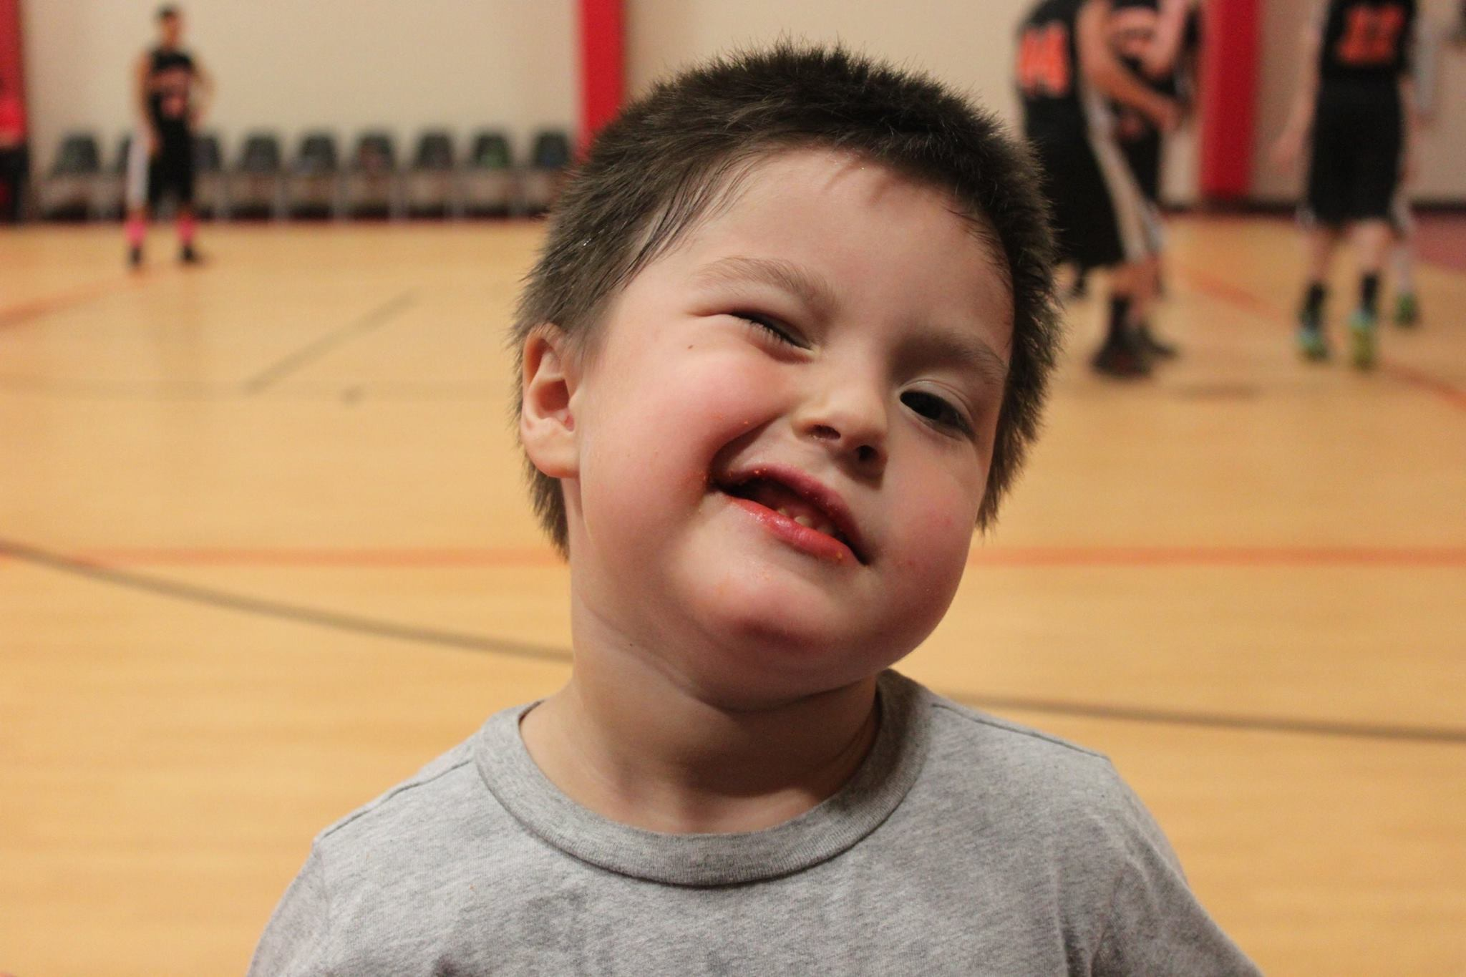
Questions/Comments
Contact Information:
  Dolly Barnes –
  Dolly.Barnes@ihs.gov
  Gen Doughty – Gdoughty@wabanaki.com
  Elizabeth Neptune – Elizabeth@NeptuneAdvantage.com
  Carry Buterbaugh, PhD- cbuterbaugh@q2evaluation.com

